Slide 1
Heart Failure Prediction

Slide 2

About our project
we propose and evaluate a heart failure prediction model leveraging machine learning techniques The outcomes of this research not only contribute to the growing body of knowledge in predictive healthcare analytics but also hold the potential to enhance early intervention strategies and improve patient outcomes in the context of heart failure prevention.

Slide 3

Introduction
The purpose of this project is to explore the applications of data science in the field of healthcare, specifically in the prediction of heart disease. The objective is to understand how various factors such as age, cholesterol levels, and exercise-induced angina contribute to heart disease

Slide 4

Literature Review
Heart failure is a common and complicated ailment. Although the biology of the condition has been better understood recently, several obstacles still need to be addressed
Support Vector Machines (SVM), Decision Trees, and K- nearest neighbors (KNN) are popular machine-learning algorithms used for diagnosing cardiac disease.To determine whether cardiac disease is present, these algorithms are frequently used with patient data such as age, sex, blood pressure, cholesterol levels, and the outcomes of several medical tests.

Slide 5

Methodology
Data Collection:
data set collected from ”Kaggle” website
the name of the data is ”heart failure prediction dataset”

Slide 6
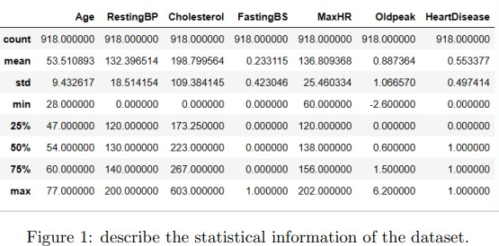
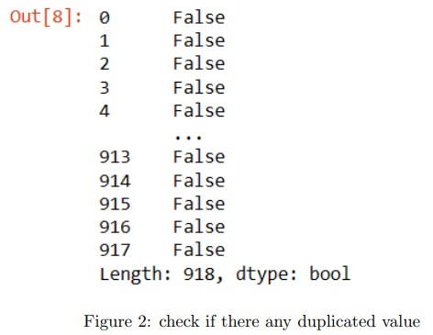
we used here function called ”df.describe()” This function we used to describe the statistical info for the dataset ; And here what we get described for the data : Count – that means the sum of all rows for each column and we get (918 cell) . Mean
– that means apart from the mode and median and the average of the given set of values. Standard deviation - measure of the amount of variation of a random variable expected about its mean . Min – that gives the minimum value in the whole dataset . Q1 “first quartile 25“50Q3 “ third quartile 75Max - that gives the maximum value in the whole dataset.
This function we used to remove duplicates if there is any in the whole dataset . df.duplicated() .
Data Cleaning and Preprocessing:
function we used to check if there any null value in the dataset. df.isna()

Slide 7
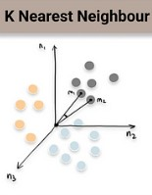
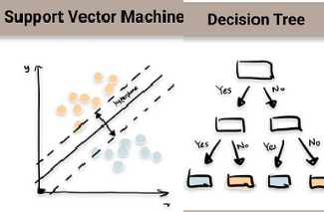
Machine Learning Models:
Our Strategy
we applied three machine models : Support Vector Classifier
Decision Tree KNeighborsClassifier
Support Vector Classifier
The hyperplane of the support vector classi fier is a decision boundary that divides the feature space into two regions
K-Neighbors Classifier
make predictions for a new data point, the algorithm identifies the k nearest neighbors in the training set based on a distance metric.
Decision Tree
determine the best features for 4 splitting the data at each decision node, aiming to create branches that segregate data points of different classes.

Slide 8

Data Description
Dataset Name: Heart Failure Detection Dataset .
Objective: The dataset aims to predict the presence or absence of heart disease
Age : Age of the patient (numeric).
Resting Blood Pressure (RestingBP): Resting blood pressure of the patient (numeric, in mm Hg)
Resting Electrocardiographic Results (RestingECG): Results of the resting electro cardiogram (categorical: Normal/Abnormalities/Probable or definite left ventricular hy pertrophy).
Sex : Gender of the patient (categorical: Male/Female).
Cholesterol: Cholesterol level of the patient (numeric, in mg/dL).
Chest Pain Type: Type of chest pain experienced by the patient (categorical: Typical Angina/Atypical Angina/Non- anginal Pain/Asymptomatic).
Fasting Blood Sugar (FastingBS): Fasting blood sugar level of the patient (categori cal: True/False).
Fasting Blood Sugar (FastingBS): Fasting blood sugar level of the patient (categori cal: True/False).

Slide 9
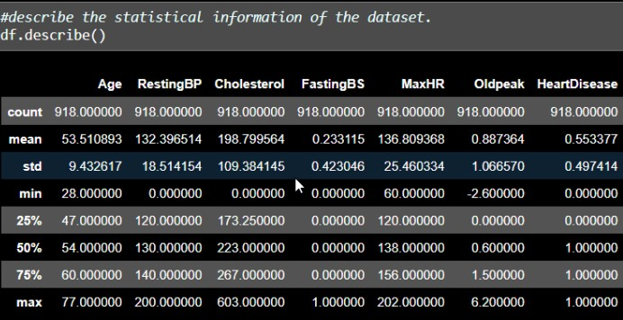
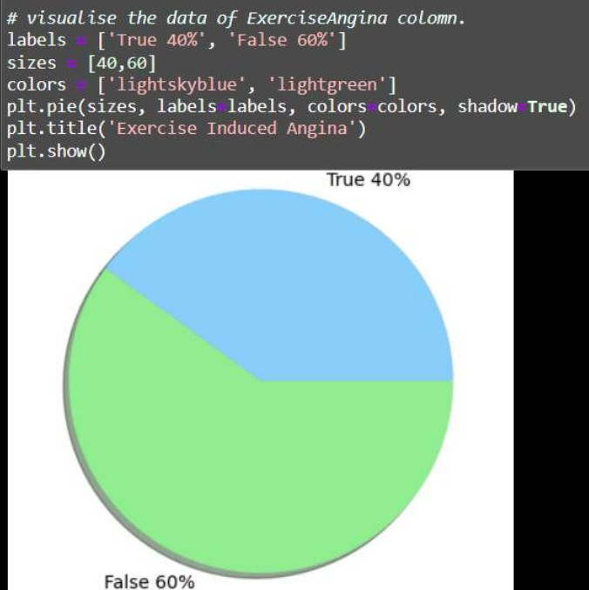
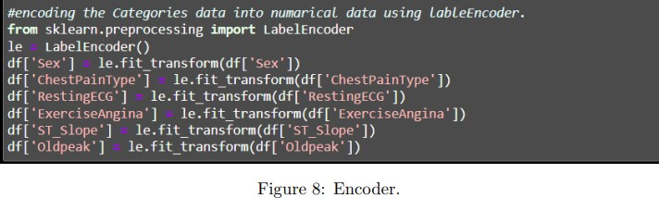
Results and Discussion
Results We analyzed the data and found statistical information for it, which is shown in the following figure. the min row describes the minimum value of each column in the dataset. the max row describes the maximum value of each column in the dataset. the Q1 determined that there are 25 percent of the dataset less than the value had in each column.

Slide 10
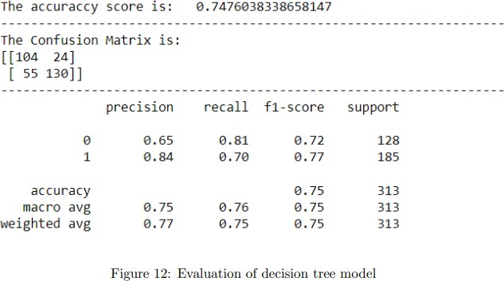
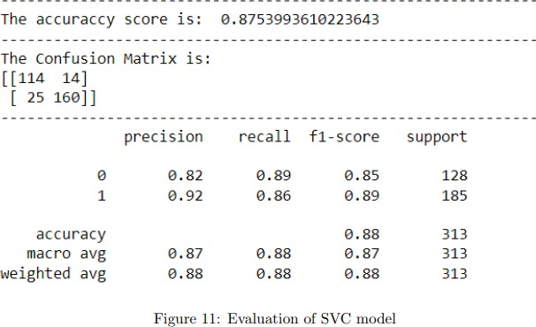
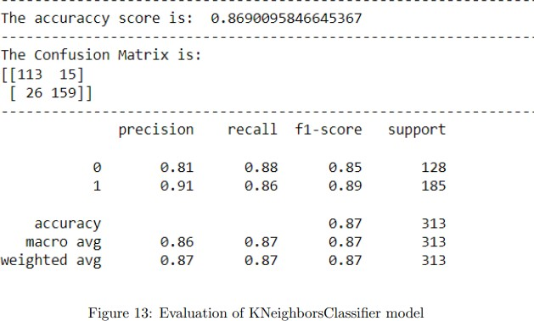
Conclusion
After extensive analysis of heart failure diag nosis databases, it is clear that several key factors play an important role in predicting 6 the presence or absence of heart failure The databases carry a variety of captive variables including quantitative data and clinical signs.

Slide 11
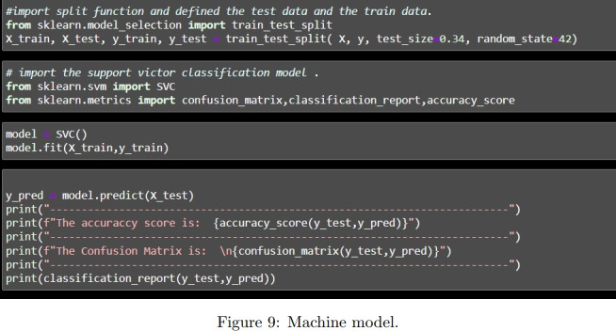
and here is the code for testing data that we give to the modle
here also we used model.fit
and gave the ‘y‘ values and ‘x‘ values.

Slide 12
Thank You

